Slide 1
DATA MODELING AND ANALYSIS OF A PROPERTY RENTAL SERVICE
BY
ANKIT OBEROI

Slide 2
OBJECTIVE
To arrange the dataset for the organization by using data modeling concept.
Determine useful insight for decision making to take better business decisions.
Tools
Microsoft SQL Server Management Studio
Excel

Slide 3
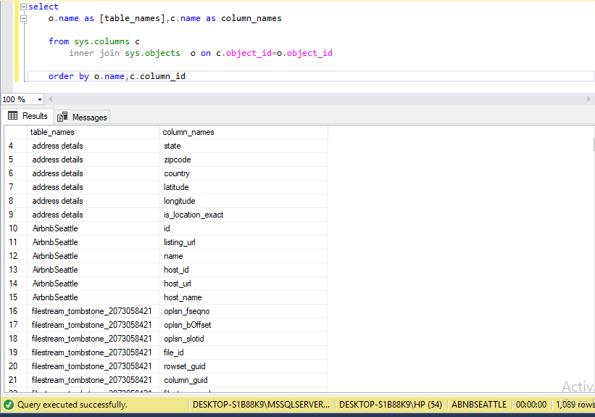
DATASET
The database contains a plethora of data which has been divided into different meaningful tables and contains useful information under different columns and unique rows.

Slide 4
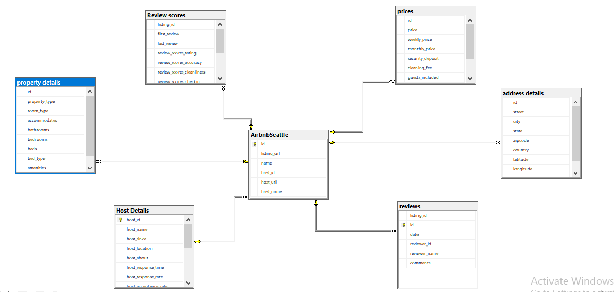
ENTITY RELATIONSHIP DIAGRAM
AIRBNB-SEATTLE is the parent table and all the other tables are connected to it.
The listing ID which is unique for every listing has been kept as primary key which is linked to foreign key of all the other tables.

Slide 5
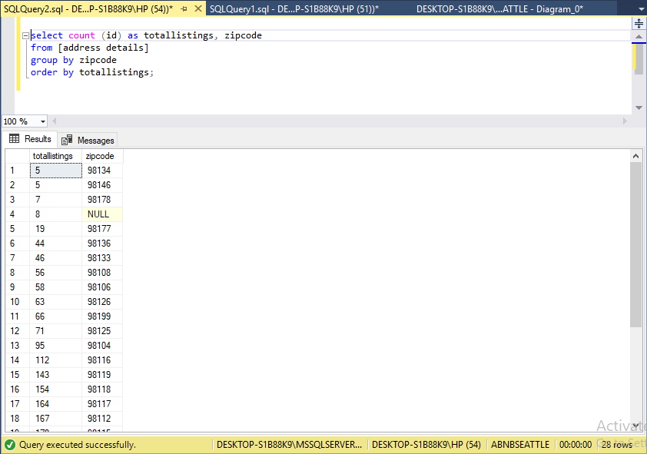
BUSINESS QUESTIONS
Q1) What is the no of listings in each zip code and which zip code has max and which has min listings?
select count (id) as totallistings, zipcode
from [address details]
group by zipcode
order by totallistings;

Slide 6
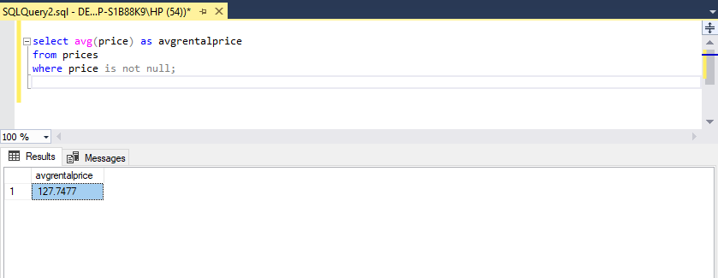
Q2) What is the avg rental price in Seattle city? What is the average rental price in each zip code?
select avg(price) as avgrentalprice
from prices
where price is not null;

Slide 7
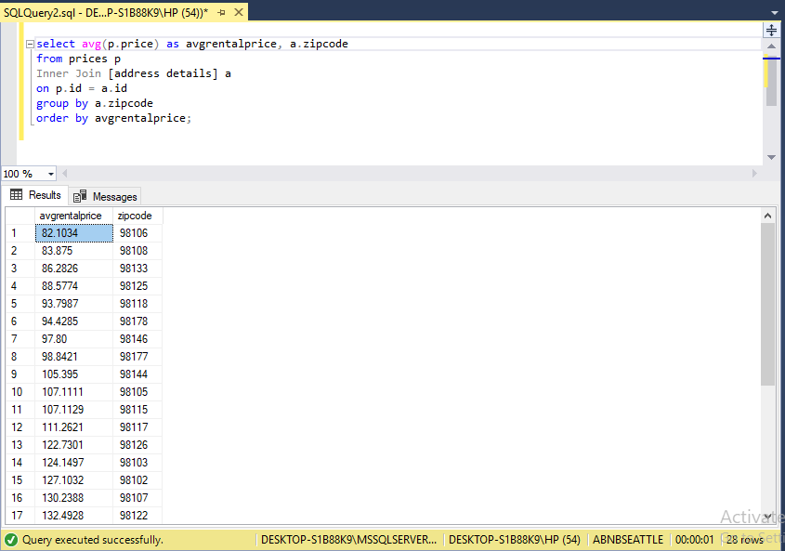
select avg(p.price) as avgrentalprice, a.zipcode
from prices p
Inner Join [address details] a
on p.id = a.id
group by a.zipcode
order by avgrentalprice;

Slide 8
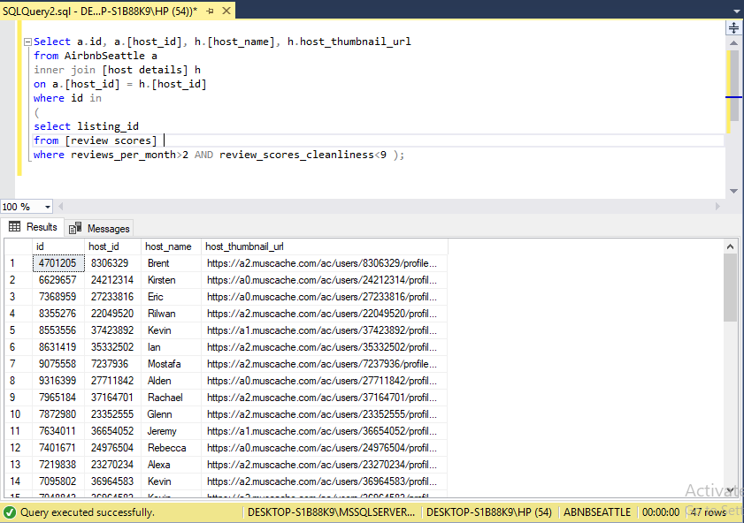
Q3) What is the average cleanliness score and which listing ids have a cleanliness score less than the avg score?
Select a.id, a.[host_id], h.[host_name], h.host_thumbnail_url
from AirbnbSeattle a
inner join [host details] h
on a.[host_id] = h.[host_id]
where id in
(
select listing_id
from [review scores]
where reviews_per_month>2 AND review_scores_cleanliness<9 );

Slide 9
CONCLUSION
The data was designed in 3NF i.e. third normal form which reduces data duplication.
Analyzed some research questions which may help the organization to take better decisions and improve the business.

